Slide 1
Agricultural Drains, Part 1
In-Class Task Script
CE En 547
Brigham Young University

Slide 2
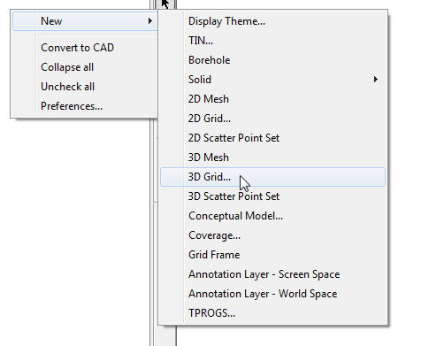
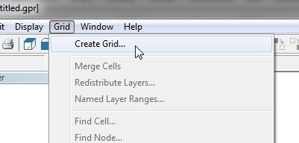
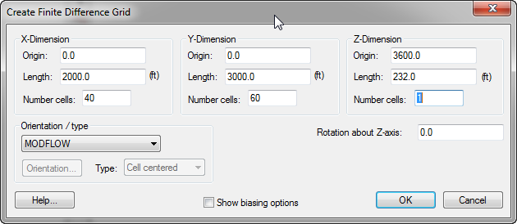
1. Build the Grid
Or

Slide 3
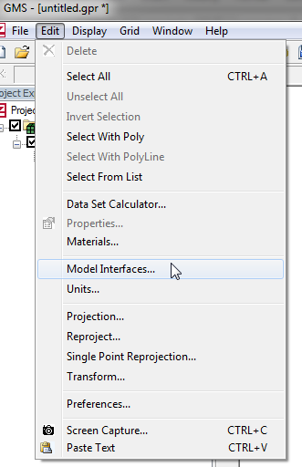
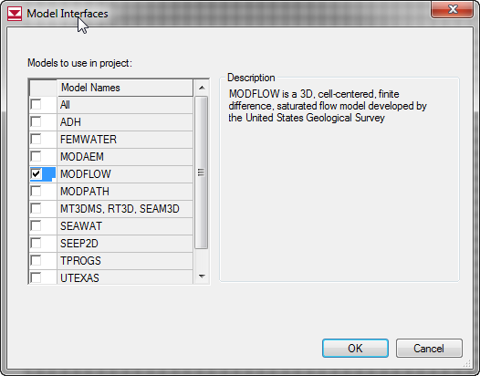
2a. Turn on MODFLOW Interface

Slide 4
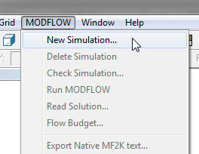
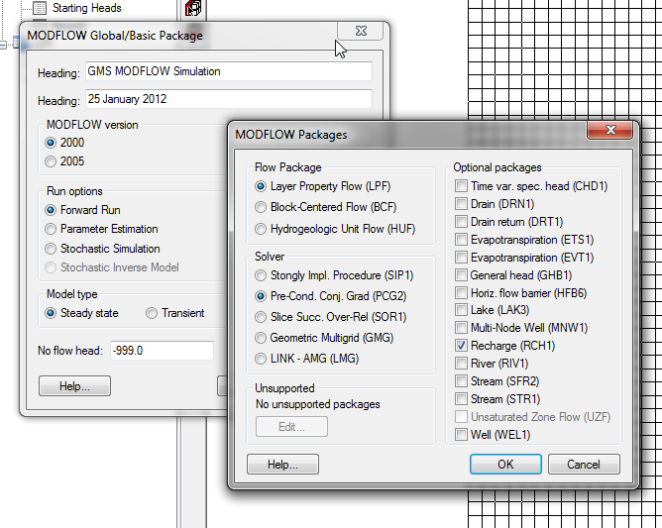
2b. Initialize MODFLOW

Slide 5
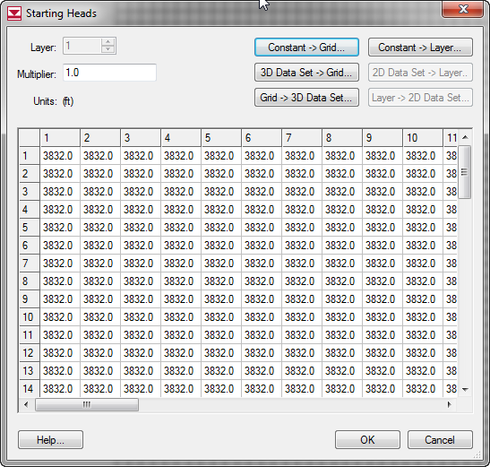
2c. Starting Heads

Slide 6
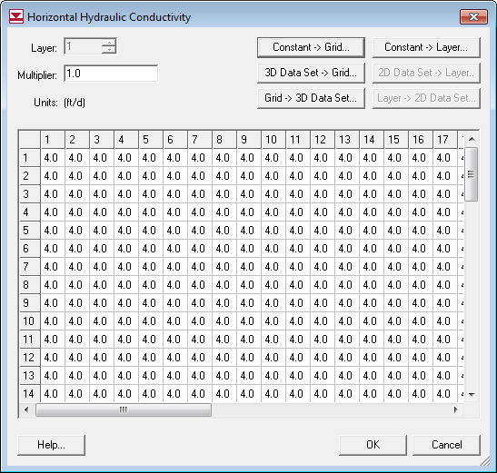
3. Assign K

Slide 7
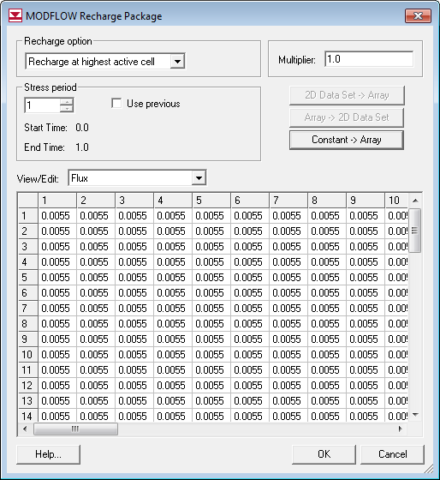
4. Assign Recharge

Slide 8
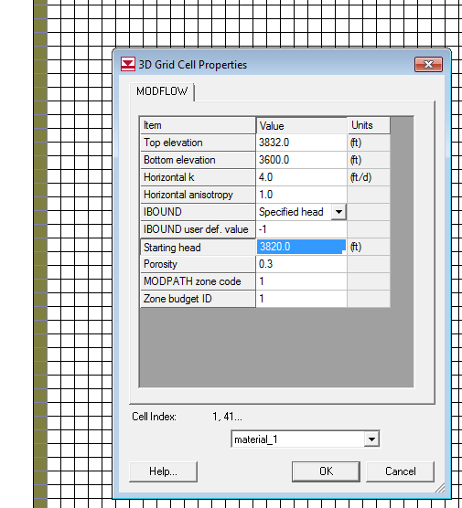
5. Spec Head Boundaries

Slide 9
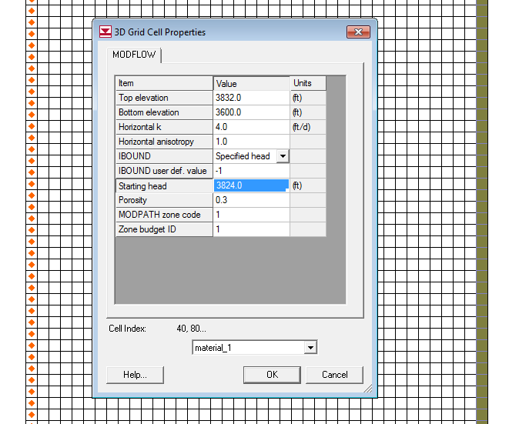
5. (other side)

Slide 10
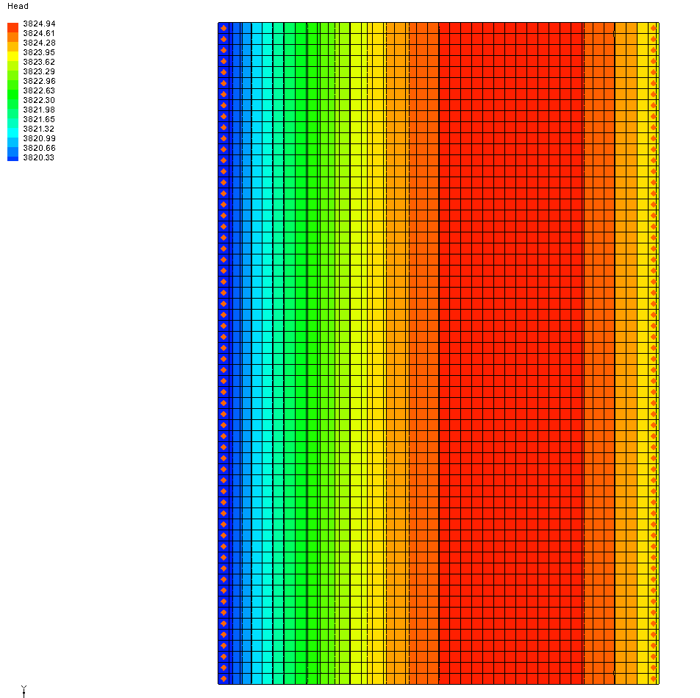
6-8. Save, Run, View

